Slide 1
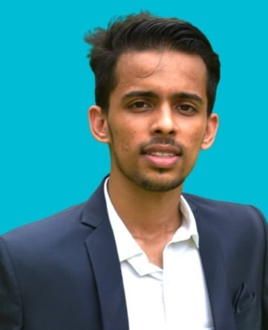



Aditya Kini
Analyst/Software Engineer
Bachelor of Engineering
Information Science : 2018 - 2022
Skills
Java 8 /J2EE | Java Basics, OOPS, Generics, Collections, Arrays, Loops, Lambda Exp, Stream API Junit, Mockito, Servlets
Spring core | IOC & Dependency Injection, Autowire
Spring REST | REST controllers, Implementation of GET, POST, PUT & DELETE, Bean Validation & Exception Handling, Testing Services, Controller & Repository layer
Spring Data JPA | Implement DAO layer using spring Data repositories, Transaction Management
Spring Boot Microservices | Spring Boot Starters, annotations, Messaging Service, Swagger API documents
Spring Cloud | Eureka, RabbitMQ, Netflix Hystrix & Config Server
React | Components, Hooks, Event handling, Redux, Reducers
Database | MongoDB No Sql Basics PostgreSQL RDS Basics
UI Tech | HTML 5 & CSS 3,JavaScript and ES6
Tools | Git, Postman, Maven, Eclipse, IntelliJ IDE
Add On skills | Communications, Team management. Peer learning
Mumbai
aditya.kini2capgemini.com
+91 8310933943
A4
Full Stack Developer
Hands on experience in creating microservices with Springboot, Spring Security, Spring Cloud API Gateway, Eureka server and Swagger
Proficient in creating a Web Application in React JS with Authentication with JUnit, Mokito Testing.
Hands on experience in implementing polyglot architecture with spring boot
Hands on experience in creating a inter-connection between two microservices and implementng a role-based feature in the application
Experience in implementing MongoDB Atlas and PostgreSQL
Hotel Management System Application
Completed end to end case study of Hotel Management System Application.React JS is used as the front end inteface and even the material UI and CSS files are added for styling.
The backend is implemented on IntelliJ platform using Java programming Language. Various features like Swagger and JWT authentication is implemented on a few pages of the application.
Doctor Booking System
Completed an end to end case study on Online Doctor Booking system using React, HTML, CSS along with PostgreSQL database
Check out my work on GitHub & Video Profile

